Slide 1
Battle of the neighborhoods
IBM Capstone Project
Name: Teo wei lung

Slide 2
Introduction
Background: As a small city state with a population of close to 6 million, Singapore has grown from third to first world in the matter of a few decades and currently have the 7th highest GDP per capita in the world. Singapore is unique with its multi-cultural character where food is one of the defining features of the country, coupled with the fact that Singapore's is wealthy and has a stable government.
Business Problem: A wealthy group of investors from Japan is thus looking to expand their presence Internationally and is looking at Singapore as their first overseas venture, to open an upscale Japanese restaurant that serves premium, authentic Japanese food where Japanese food is highly favored amongst diners.
Goal: I have been tasked to determine the best location in Singapore to set up shop based on the criteria identified by the investors.

Slide 3
Data
GenHouseholdSurvey2015.csv, downloaded from the Department of Statistics Singapore with information about Resident Households by District and Monthly Household Income from Work. This will help us identify the districts in Singapore with higher income levels which is the target audience of the new restaurant.
Foursquare API: provides API to find out information about the popularity of different food venues in Singapore e.g. each district's preferences of food venues

Slide 4
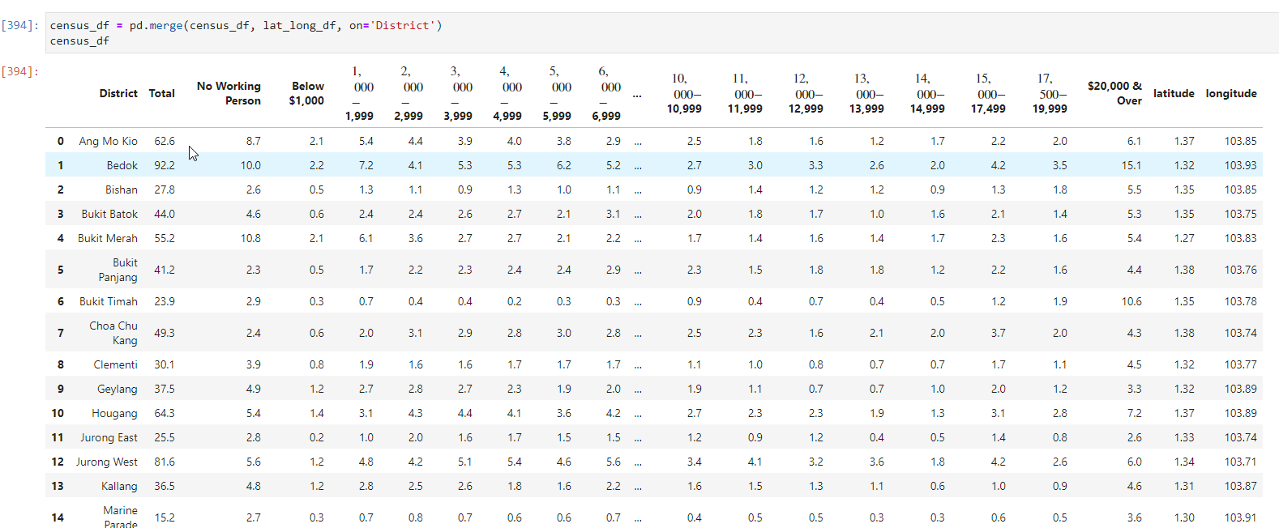
Methodology
Reading CSV data into pandas dataframe

Slide 5
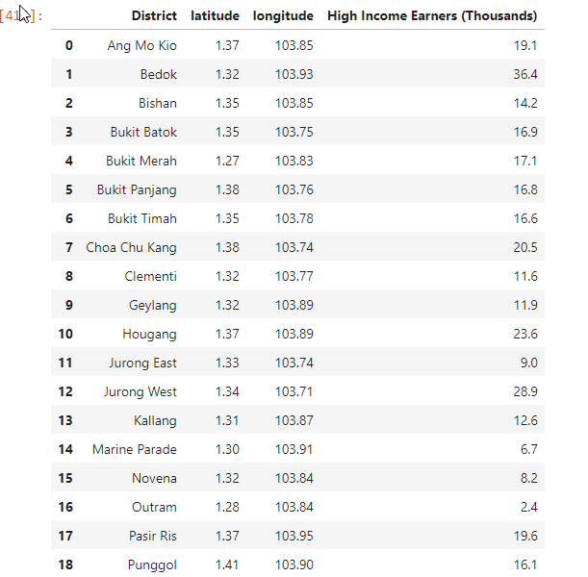
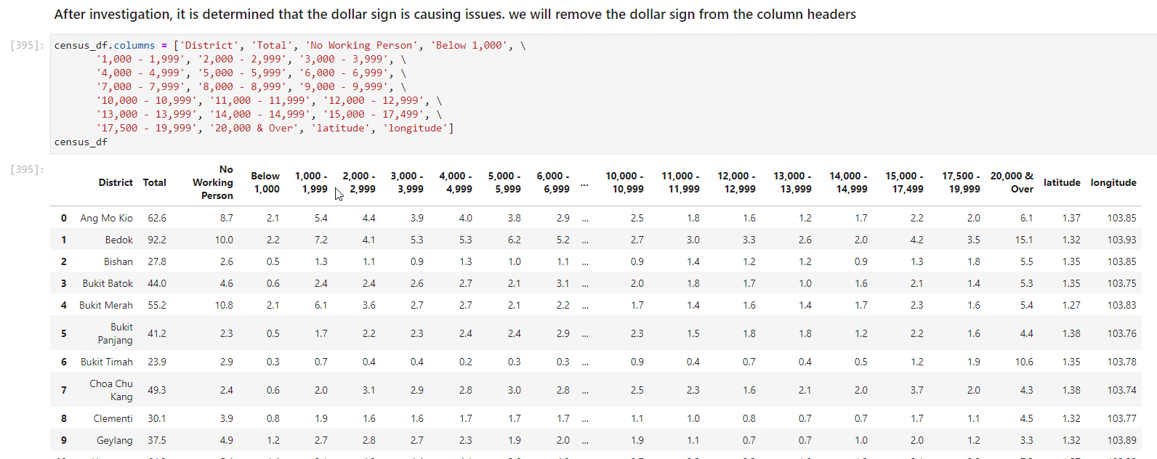
Methodology
Data cleaning & wrangling & feature selection
Remove special formatted characters from headers
Remove unimportant data rows
Add up certain columns to get “high income earner” data instead of columns by income level. Drop the rest of the columns that are not required

Slide 6
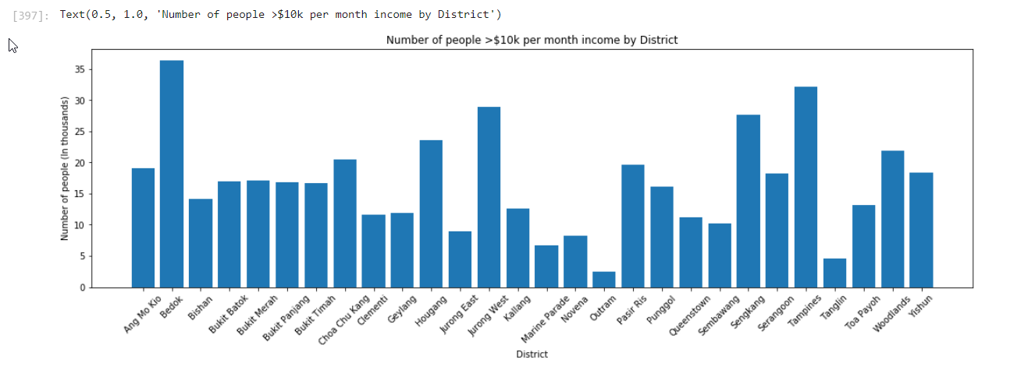
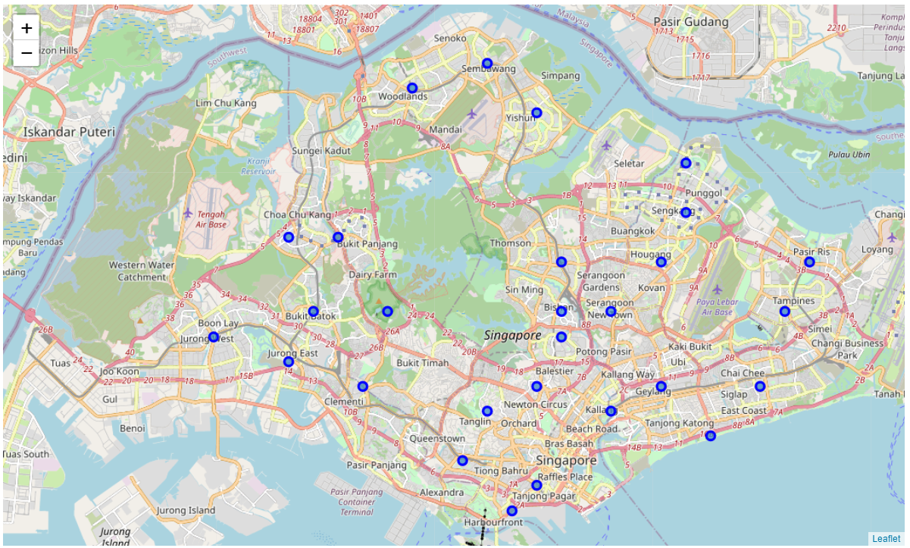
Methodology
Initial Data Analysis
Histogram plot of high income earners by district
Highest figures from Bedok, Tampines and Jurong West
Map plot of districts in Singapore

Slide 7
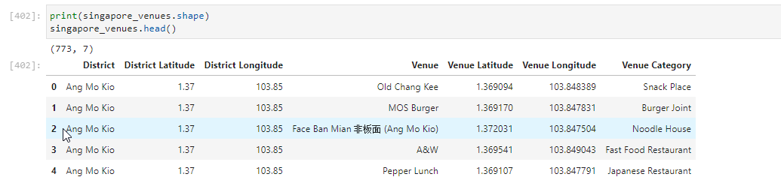
Methodology
Foursquare API
For each district, we call the “Explore” API to find recommended food venues and the venue categpry within 500 meters from the district center

Slide 8
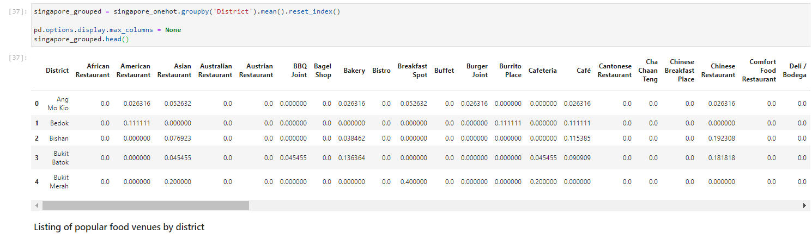
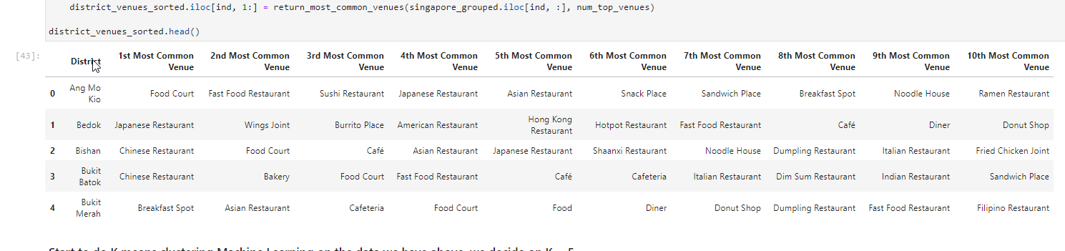
Methodology
Data transformation
One hot encoding of the 76 venue categories so that we can determine venue frequency mean values
Transformed data into a dataframe detailing most common venue by district

Slide 9
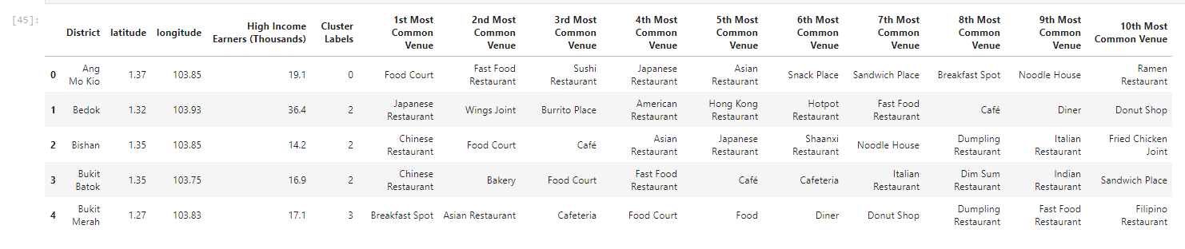
Methodology
Machine Learning (K-means)
K = 5
Cluster labels appended to dataframe

Slide 10
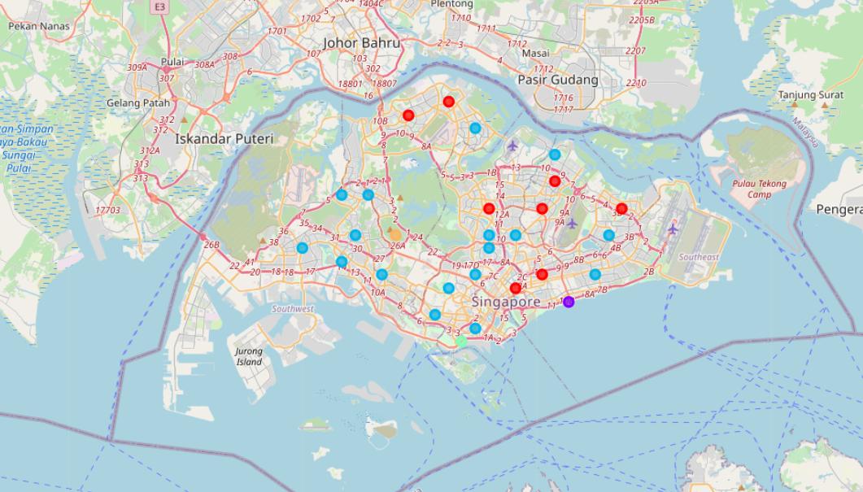
Methodology
Clusters plotted on Folium map

Slide 11
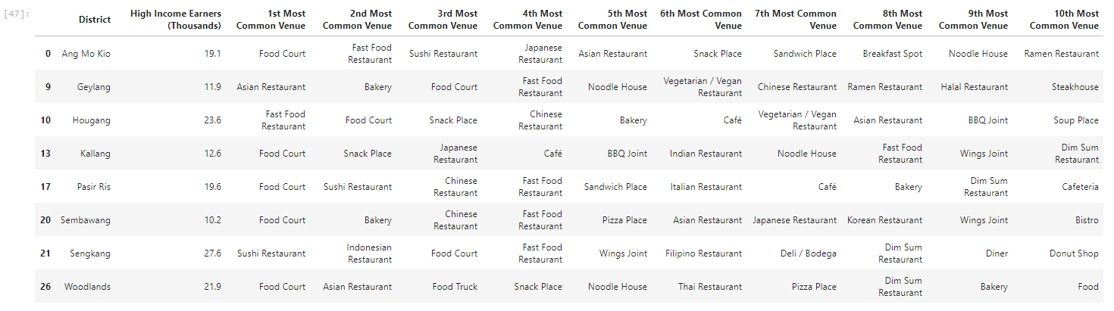
Results
Cluster 0 (Most prefer eating at food courts / low cost sushi chains / fast food)
Cluster 1 (Marine Parade is situated in the city centre, most visited venue is the café probably because it is a popular place to do work / have meetings / lunch)

Slide 12
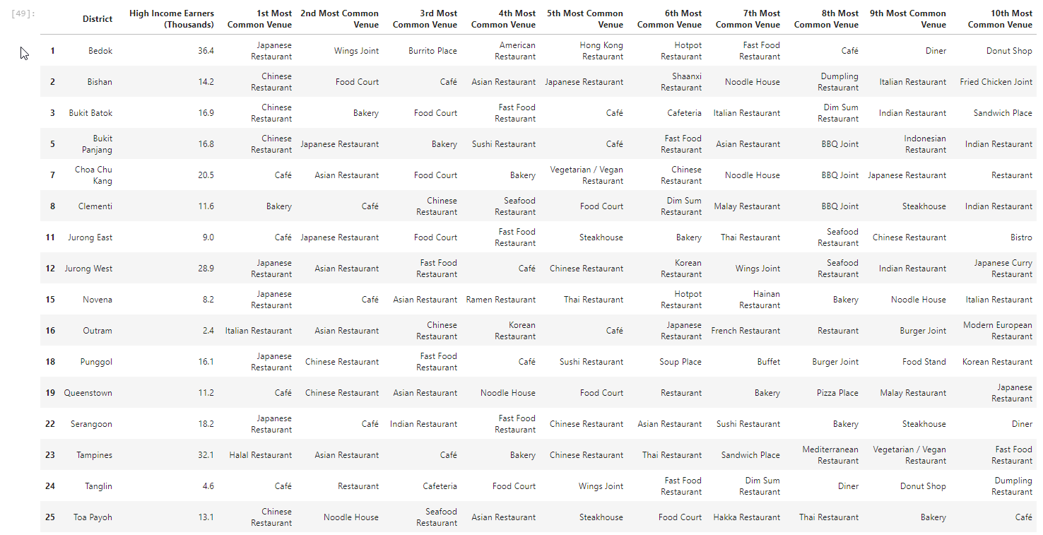
Results
Cluster 2 (Most promising cluster with many districts preferring Japanese restaurants)

Slide 13
Results
Cluster 3 (This cluster at Bukit Merah prefer “Breakfast Spot”, referring to hawker centers and affordable, neighborhood food fare)
Cluster 4 (Bukit Timah has got high preference for Halal cuisine. Not what the client is looking for)

Slide 14
Discussion
Important factors that were not examined in this exercise
Space rental costs
Presence of competitors serving similar Japanese cuisine at each districts
Weakness of exercise:
Income data was from 2015 (latest data available as of 2020) and thus may have deviations from the real data today
Others:
Singapore is a small country, people like to travel to the city centre to meet their friends & families to have meals together
Hence, the central part of Singapore may potentially be more advantageous to maximising audience reachability
e.g. Jurong West located at the Western end of Singapore has got a high number of high-income earners as well. Opening the restaurant in Bedok which is situated East of the country, can discourage people from Jurong West from visiting the restaurant
Consider performing further analysis and entertaining the possibility of setting up the shop somewhere in the central part of Singapore instead of Bedok

Slide 15
Conclusion
From the results, Cluster 2 (Light Blue) has got the highest preference for Japanese cuisine, especially the districts Serangoon, Jurong West and Bedok, Punggol, Novena.
Thus, it is fairly safe to conclude that the new shop should be set up somewhere in Cluster 2.
Now we sort the Cluster 2 Districts by number of high-income earners to decide the best district within the cluster to set up shop

Slide 16
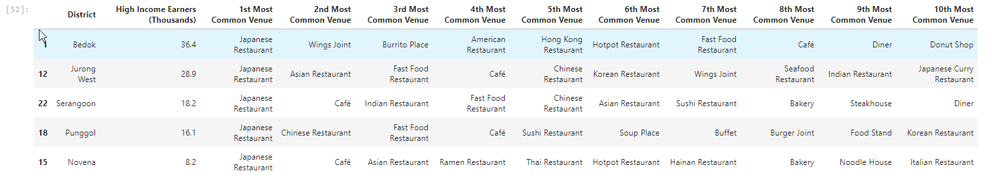
Conclusion
The district winner is Bedok! Jurong West is a strong runner-up to set up a Japanese restaurant as well.

